Slide 1
FUNDAMENTALS OF IMAGE PROCESSING
M-1 T-3

Slide 2
HISTOGRAM EQUALIZATION
2. Consider 4-bit image of 4x4 dimension and perform the following operations [[10,12,8,9],[10,12,12,14],[12,13,10,9],[14,12,10,12] À)Apply histogram equalization to the image by rounding image pixels to integers.
B)sketch the histogram of the original image and histogram equalized image.
C)Can you think of scenarios where histogram equalization might not be the most appropriate technique for contrast enhancement?

Slide 3
HISTOGRAM EQUALIZATION STEPS
A) To perform histogram equalization on the given 4x4 image, we'll follow these steps:
Calculate the histogram of the original image.
Compute the cumulative distribution function (CDF) of the histogram.
Normalize the CDF to the range [0, 255].
Map the original pixel intensities to their corresponding equalized intensities based on the normalized CDF.
Round the equalized intensities to integers.

Slide 4
ORIGINAL IMAGE
IMAGE=[ [10, 12, 8, 9],
[10, 12, 12, 14],
[12, 13, 10, 9],
[14, 12, 10, 12] ]
Performing histogram equalization on above image.
Grey levels | 0-7 | 8 | 9 | 10 | 11 | 12 | 13 | 14 | 15
No of pixels | 0 | 1 | 2 | 4 | 0 | 6 | 1 | 2 | 0
Running sum | 0 | 1 | 3 | 7 | 7 | 13 | 14 | 16 | 16
Running sum/Total no of pixels | 0/16 | 1/16 | 3/16 | 7/16 | 7/16 | 13/16 | 14/16 | 16/16 | 16/16
Result * max gray level | 0*15 | 1/16 * 15 | 3/16 * 15 | 7/16 * 15 | 7/16 * 15 | 13/16 * 15 | 14/16 * 15 | 15 | 15

Slide 5
ORIGINAL IMAGE Equalized image
IMAGE=[ [10, 12, 8, 9], IMAGE=[[ 63, 127, 0, 63],
[10, 12, 12, 14], [ 63, 127, 127, 215],
[12, 13, 10, 9], [127, 191, 63, 0],
[14, 12, 10, 12] ] [215, 127, 63, 127] ]

Slide 6
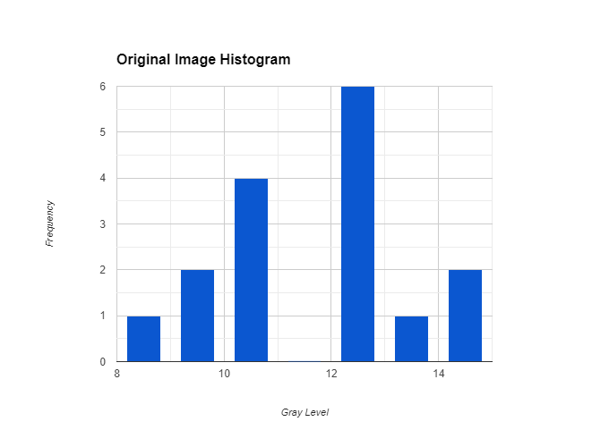
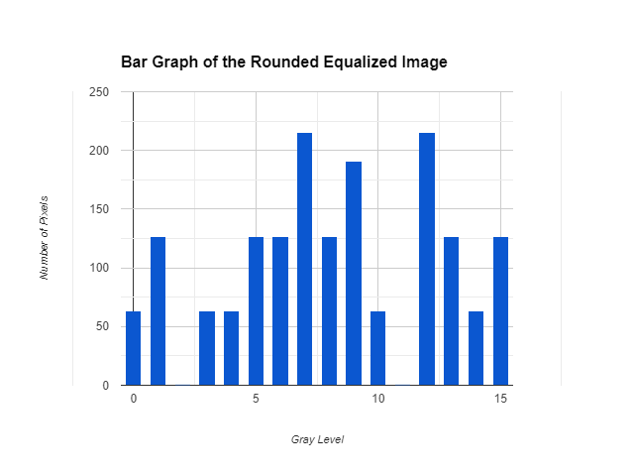
B) Sketching the histogram of the original image and the histogram equalized image would require plotting the frequency of pixel intensities.

Slide 7
C) Histogram equalization might not be the most appropriate technique for contrast enhancement in scenarios where:
Non-uniform Distribution: If the original image already has a relatively uniform distribution of pixel intensities, histogram equalization might distort the contrast and make the image appear unnatural.
Extreme Pixel Values: Histogram equalization can amplify noise in images with extreme pixel values. In such cases, other techniques like adaptive histogram equalization might be more suitable.
Local Contrast Enhancement: Histogram equalization treats the entire image globally. In scenarios where local contrast enhancement is necessary, other techniques like adaptive histogram equalization or contrast limited adaptive histogram equalization (CLAHE) might be more effective.
Computational Cost: Histogram equalization can be computationally expensive, especially for large images or real-time applications. In such cases, faster techniques like contrast stretching or gamma correction might be preferred.

